Slide 1
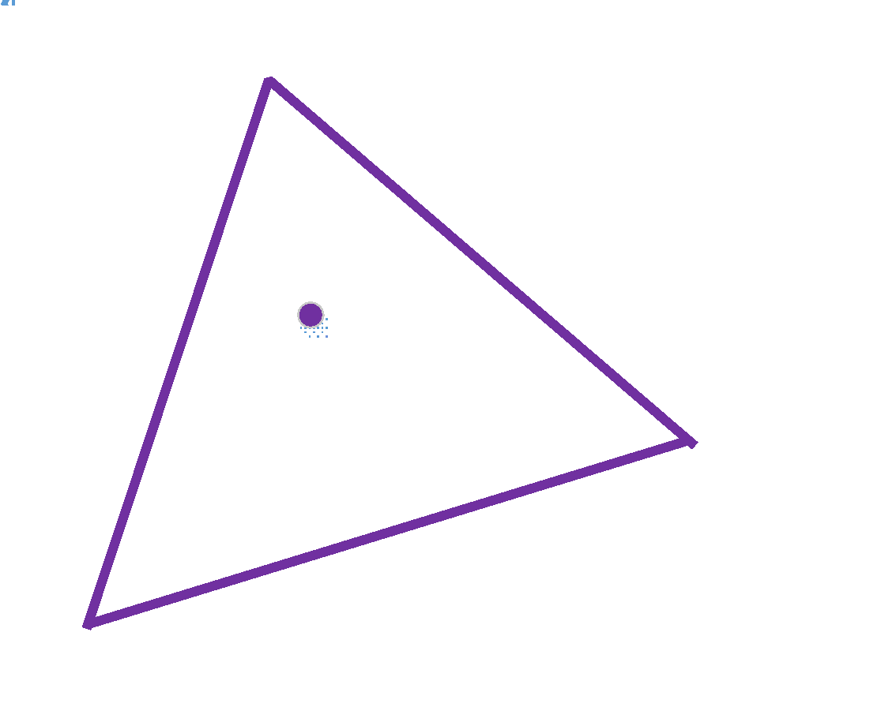
Assignment 1
Interpolation using linear equations of plane co-efficients
cx*x0 + cy*y0 + ck = q0
cx*x1 + cy*y1 + ck = q1
cx*x2 + cy*y2 + ck = q2
cx*x + cy*y + ck = q
Solve for cx, cy, ck
And give the interpolation equation for x,y

